Slide 1
An Efficient Circular Block Approach for Copy-Move Forgery Detection
Islamic University of Technology (IUT)
Department of Computer Science and Engineering(CSE)
Supervised by
Md. Hasanul Kabir, PhD.
Assistant Professor, CSE Dept.
Islamic University of Technology(IUT)
Presented by
Rafsanjany Kushol 094404
Md. Sirajus Salekin 094405
Date: 10 September, 2013

Slide 2
Outline
Introduction
Copy-Move Forgery
Research Challenges
Thesis Objectives
Literature Review
Proposed Method
Dataset and Implementation
Experimental Results
Conclusion and Future work
References

Slide 3
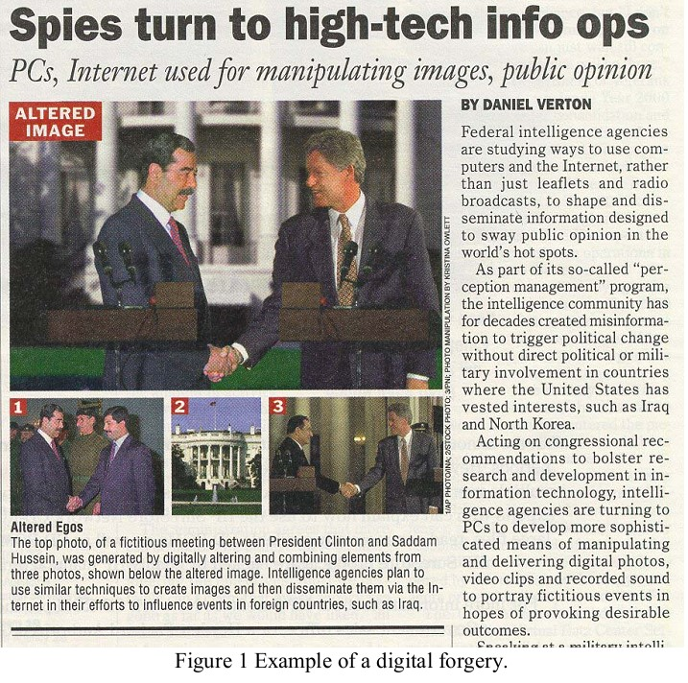
Introduction
Digital image forgery is simply nothing but adding or removing important features from an image without leaving any traces of tampering
The main aim of a forged image is something like
Deleting or hiding a region in the image
Adding any new object into the image
Misrepresenting the image information etc.
Several types of Digital forgery can be happened in an image like
Splicing means creating a forged image from several images
Tampering by blurring, illumination, contrast changing etc.
Copy-move forgery
Our focus is on Copy-move forgery in digital image

Slide 4
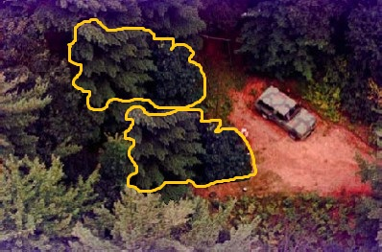
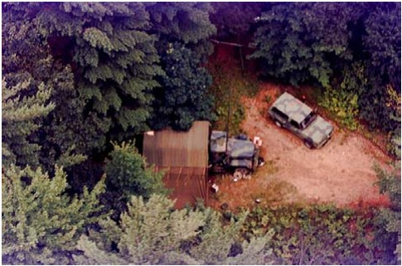
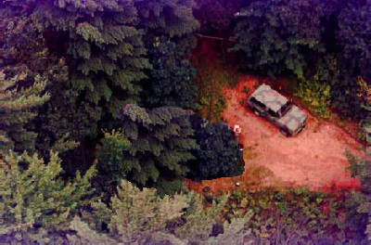
Copy-move forgery
Copy-move forgery is a special type of digital forgery in which a part of the image is copied and pasted somewhere else in the image with the intent to cover an important image feature
Fig: Original Image
Fig: Forged Image

Slide 5
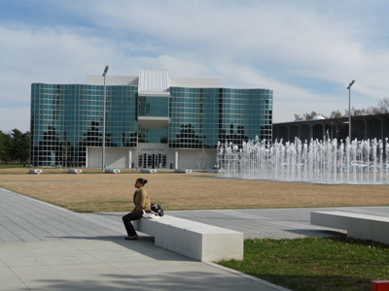
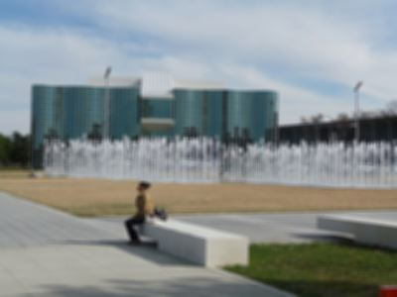
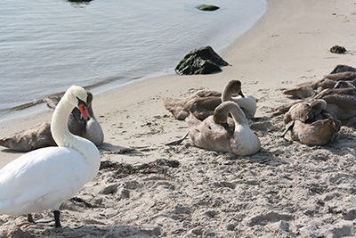
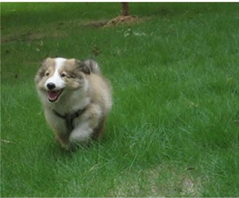
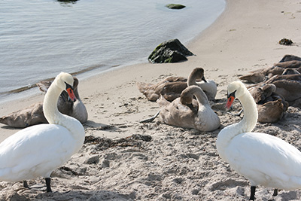
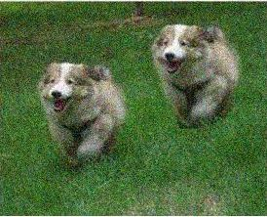
Research Challenges
In copy-move forgery there are several challenges like
JPEG Compression
Flat or uniform region
Presence of noise
Image may be blurred
Segment may be flipped
Segment may be rotated
Segment may be scaled
Blurred image
Noisy image
Flipped image

Slide 6
Thesis Objectives
So our main objectives of this thesis is to develop a new method for detecting copy-move forgery which is
Robust against JPEG compression, random noise and Gaussian blurring
Able to detect forgery despite of Rotation or flipping
Providing less false positive response even if the image contains uniform or flat region
Computationally efficient

Slide 7
Literature Review
Although many papers have been published suggesting different detection techniques, the challenges which are faced have not been overcome yet. Every algorithm has some lacking & limitations.
We can group these existing methods in several types:
Feature Extraction Approach
Example: DCT, PCA, DWT & SVD
Sub-Blocking Approach
Example: 7 features, 9 features, DWT & features
Rotation & Scale invariant Approach
Example: SIFT, LBP
Circular Block Extraction Approach
Example: DCT grid & BAG , BAM

Slide 8
Proposed Method
Skeleton of Proposed Method
Pre-processing
Circular Block Extraction
Feature Extraction
Detected Copied Region
n^{th} consecutive comparison
Sorting the blocks

Slide 9

Proposed Method(cont.)
Block & Feature Extraction
Each block contains 3 concentric
circles with different radius
For each block, 12 features
will be calculated
$f_{i}=µ \left(circle i\right)$ where $i=1,2,3$
$f_{3+i}=\frac{\sum{{(I_{i }\left(x,y\right)−µ_{i})}^{2}}}{µ_{i}}$ where $i=1,2,3$
$f_{6+i}= \frac{fi}{f1+f2+f3}$ where $i=1,2,3$
$f_{6+i}= \frac{fi}{f4+f5+f6}$ where $i=4,5,6$
Circle 1
Circle 2
Circle 3

Slide 10
Proposed Method(cont.)
Sorting and Comparison
For finding any similar block, each block checks its next n^{th} consecutive blocks
Distance threshold, Frequency threshold and Feature threshold are used to take the final decision of similarity match
block i
block i
block i+1
block i+1
block i+2
block i+2
block i+3
block i+3
block i+4
block i+4
block i+5
block i+5
block i+6
block i+6
block i+7
block i+7
Fig: n^{th} Consecutive block searching

Slide 11
Dataset and Implementation
Dataset:
We have collected benchmark data from internet
Using Adobe Photoshop we have also made some forged images
First part of our dataset contains forged images without any modification
Second part of the dataset is formed with compressed images with different quality factor
Third part of the dataset contains some Noisy images with different SNR db.
Fourth part of the dataset contains some Rotated and flipped images
Fifth and last part of our dataset is formed with some blurred images for different standard deviation
Implementation:
Implementation is done with Matlab 2010
Already we have implemented several existing methods & made a comparison with our own detection method

Slide 12
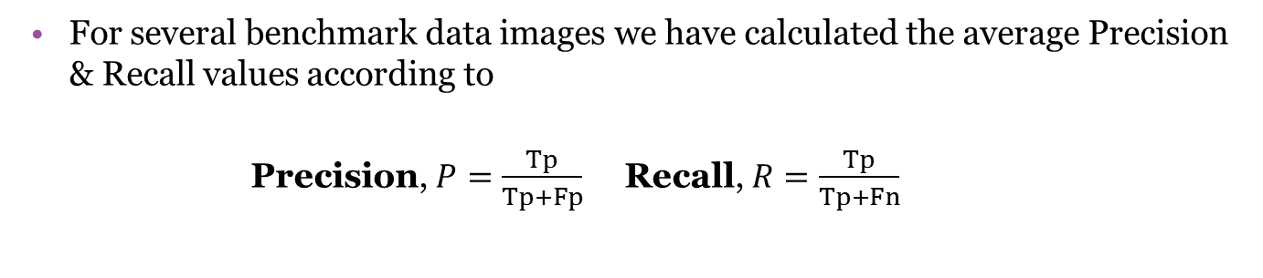
Experimental Results
For several benchmark data images we have calculated the average Precision & Recall values according to
Precision, $P=\frac{Tp}{Tp+Fp}$ Recall, $R=\frac{Tp}{Tp+Fn}$

Slide 13
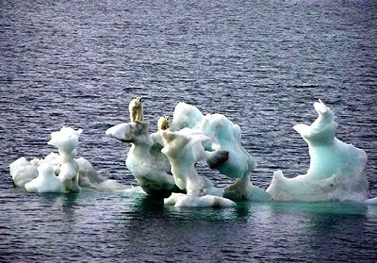
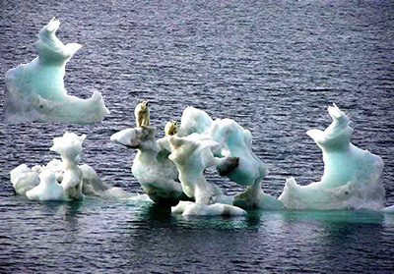

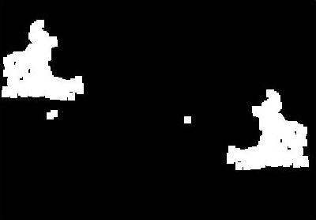
Experimental Results
For Rotation & Flipping
Fig: Original Image
Fig: Forged Flipped Image
Fig: Ground truth
Fig: Output result image

Slide 14
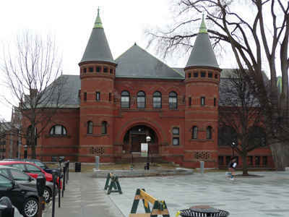
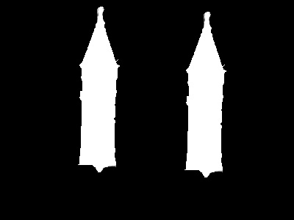
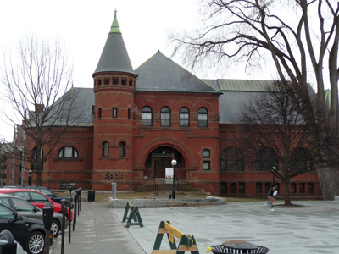
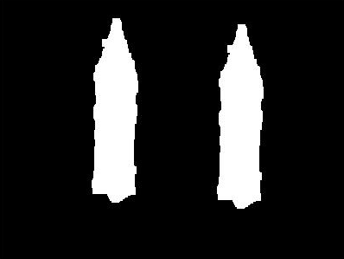
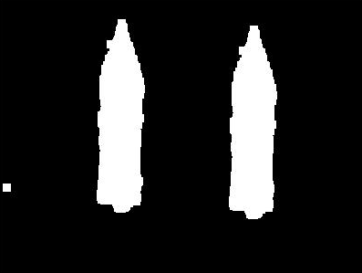
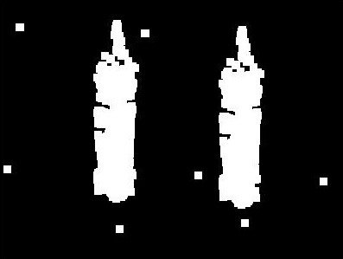
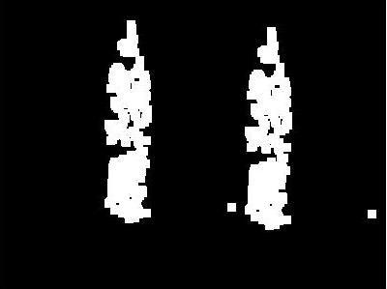
Experimental Results(cont.)
For JPEG Compression
Fig: Forged Image
Fig: Ground truth
Fig: Output result image
Fig: For quality factor 90
Fig: For quality factor 70
Fig: For quality factor 50

Slide 15
Experimental Results(cont.)
For several JPEG compression quality factor, Precision & Recall Comparison
Precision
Recall

Slide 16
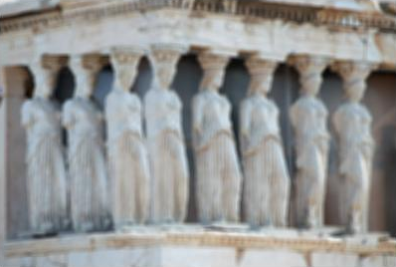

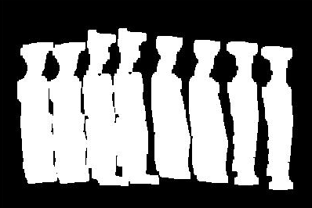
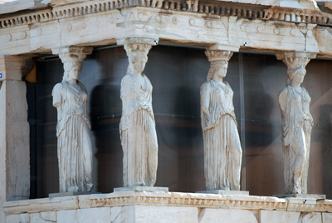
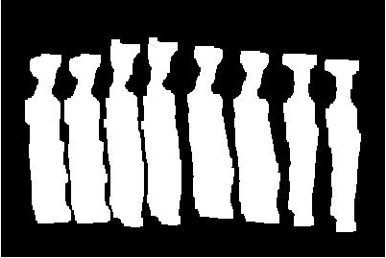


Experimental Results(cont.)
For Blurred Image
Fig: Forged Image
Fig: Ground truth
Fig: Output result image
Fig: For standard deviation 2
Fig: For standard deviation 4
Fig: For standard deviation 6

Slide 17
Experimental Results(cont.)
For different Standard deviation, the Precision & Recall Comparison for blurred images
Precision
Recall

Slide 18

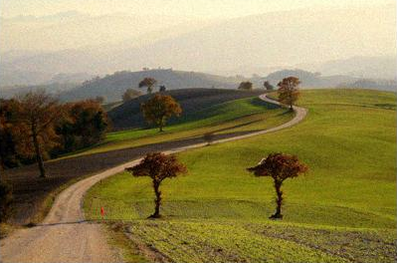
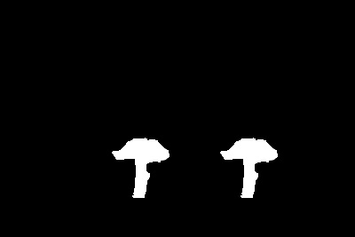




Experimental Results(cont.)
For Noisy Image
Fig: Forged Image
Fig: Ground truth
Fig: Output result image
Fig: For SNR db 40
Fig: For SNR db 30
Fig: For SNR db 20

Slide 19
Experimental Results(cont.)
For different SNR (db), the Precision & Recall Comparison for Noisy images
Precision
Recall

Slide 20
Conclusion and Future Work
We have investigated the existing methods for identifying their weakness and tried to resolve it using our proposed method
Combination of mean, contrast and different ratio of circular blocks for feature selection makes our detection method more robust against different challenges like Gaussian Noise, Gaussian Blurring, JPEG compression etc.
Using circular blocks provides us rotation and flip invariant features without measuring any complex calculation
Comparison with n^{th} consecutive blocks for match finding finally gives us more accurate result for modified images
Although our proposed method is robust against different challenges like noise, blurring, compression, rotation etc. but it has some limitations like
Some false positive result for rotation if the image area is bested with flat or uniform region
Our proposed method will not work if the forged image is scaled
So further development of this proposed method is to
decrease the false positive response for rotation
try to make it scale invariant detection method

Slide 21
Thank You
Questions?

Slide 22
References
J. Fridrich, David Soukal & Jan Lukas “Detection of Copy-Move Forgery in Digital Images” in Proceedings of Digital Forensic Research Workshop, August 2003.
A. Popescu, H. Farid “Exposing digital forgeries by detecting duplicated image regions”, Technical Report TR2004-515, Department of Computer Science, Dartmouth College, 2004.
W. Luo, J. Huang and G. Qiu, “Robust detection of region-duplication forgery in digital image”, ICPR ’06: Proceedings of the 18th International Conference on Pattern Recognition, IEEE Computer Society, Washington, DC, USA ,pp. 746–749. ,2006.
Guohui Li, Qiong Wu, Dan Tu, Shaojie Sun, “A sorted neighborhood approach for detecting duplicated region in image forgeries based on DWT and SVD”, IEEE, ICME , 2007.
W. Luo, J. Huang and G. Qiu, “Robust detection of region-duplication forgery in digital image”, ICPR ’06: Proceedings of the 18th International Conference on Pattern Recognition, IEEE Computer Society, Washington, DC, USA ,pp. 746–749.,2006.
Junwen Wang, Guangjie Liu, Hongyuan Li, Yuewei Dai, Zhiquan Wang "Detection of Image Region Duplication Forgery Using Model with Circle Block" mines, vol. 1, pp.25-29, 2009 International Conference on Multimedia Information Networking and Security, 2009.
H. J. Lin, C.-W. Wang, Y.-T. Kao“Fast copy–move forgery detection”, WSEAS Transactions on Signal Processing 5 (5), 2009.

Slide 23
References
Sunil Kumar et al. “Copy-Move Forgery Detection in Digital Images: Progress and Challenges ” International Journal on Computer Science and Engineering (IJCSE), ISSN : 0975-3397Vol. 3 No. 2 Feb, 2011.
Christlein et al. “An evaluation of popular copy-move forgery detection approaches” IEEE Transactions on information forensics and security, 2012.
M.Sridevi, C.Mala and S.Sandeep “Copy-move image forgery detection in a parallel environment” SIPM, FCST, ITCA, WSE, ACSIT, CS & IT 06, pp. 19–29, 2012.
Christlein et al. “An evaluation of popular copy-move forgery detection approaches” IEEE Transactions on information forensics and security, 2012.
M.Sridevi, C.Mala and S.Sandeep “Copy-move image forgery detection in a parallel environment” SIPM, FCST, ITCA, WSE, ACSIT, CS & IT 06, pp. 19–29, 2012.
Vivek Kumar Singh and R.C. Tripathi, “Fast and Efficient Region Duplication Detection in Digital Images Using Sub-Blocking Method”, International Journal of Advanced Science and Technology Vol. 35, October, 2011.

